Slide 1

InnSpect
Chang Zhang
Insight 2019 C

Slide 2



Groupon is ambitious in travel market

Slide 3
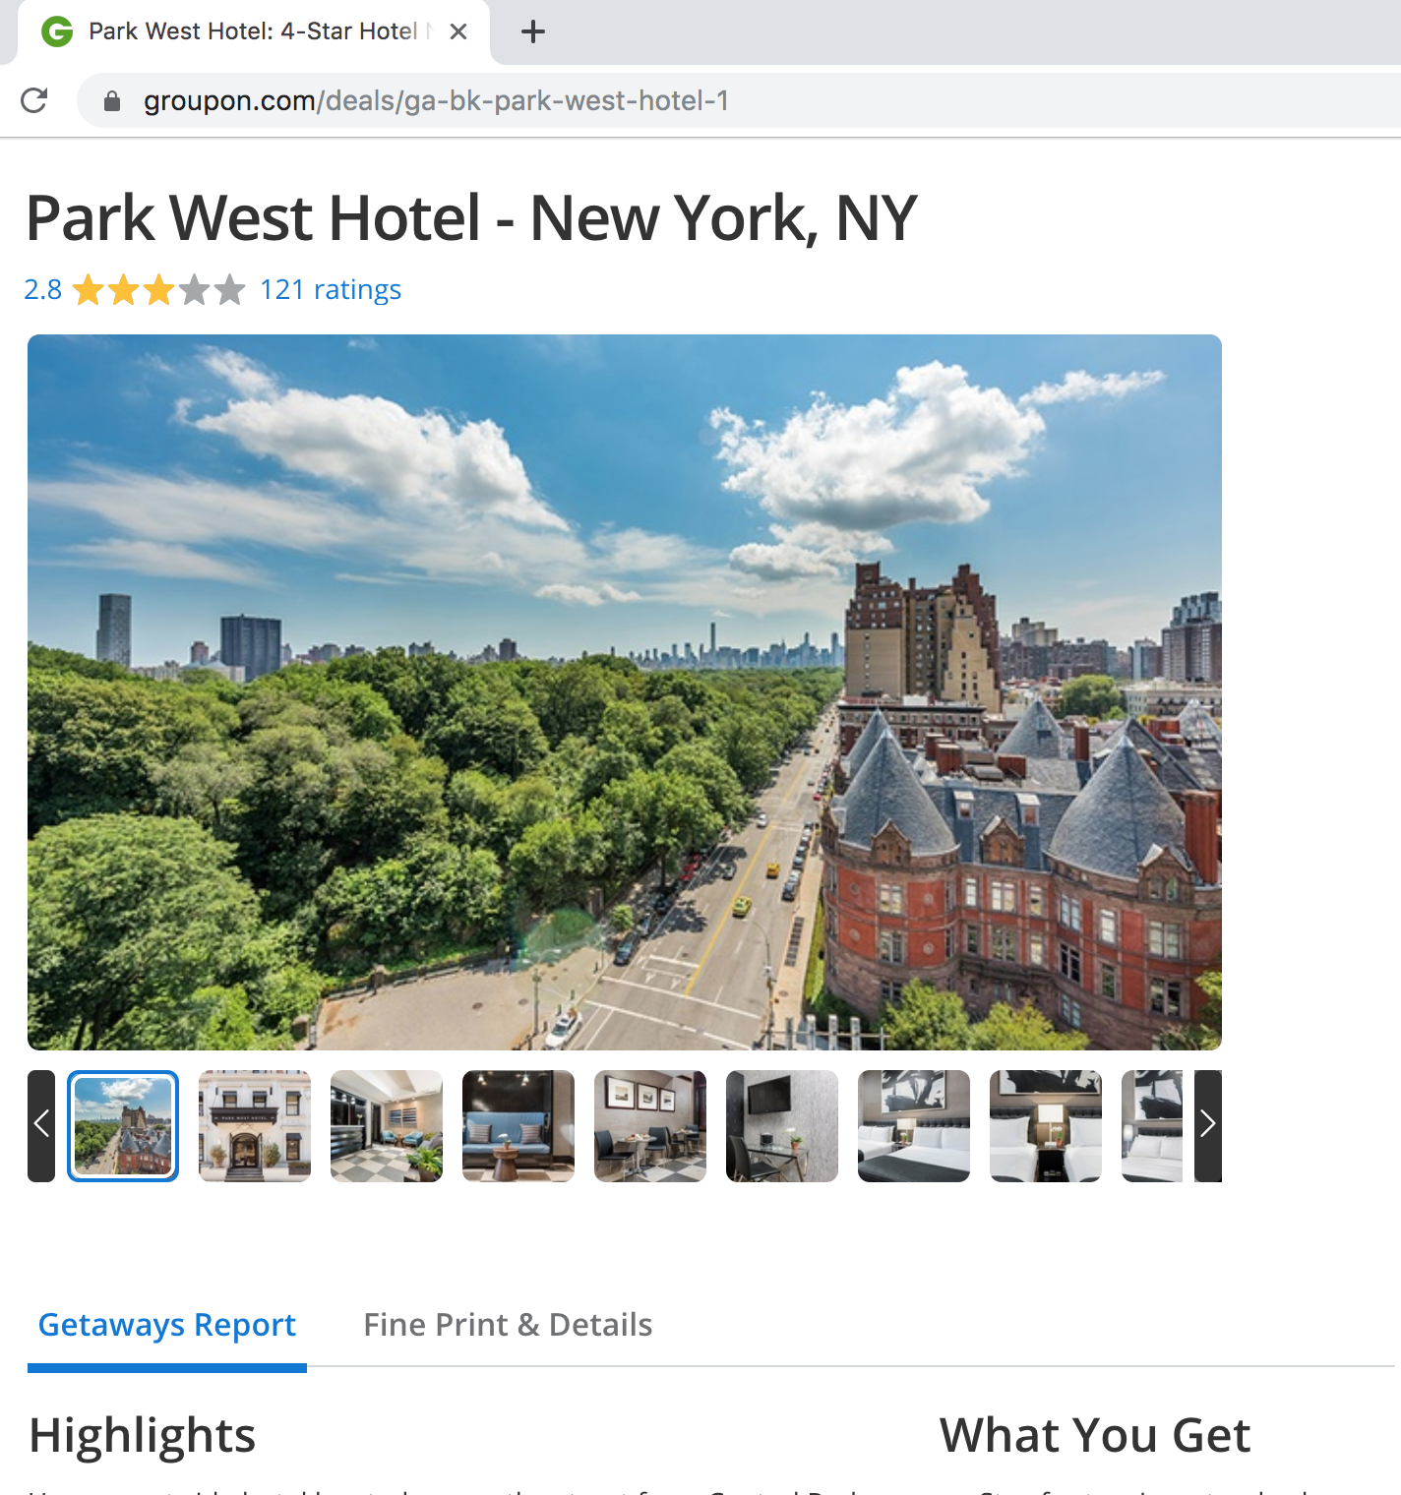

Important Feature Missing from Groupon Hotel Page
Groupon

Slide 4
Important Feature Missing from Groupon Hotel Page
Room?
Location?
Service?
Food?
…
Groupon

Slide 5
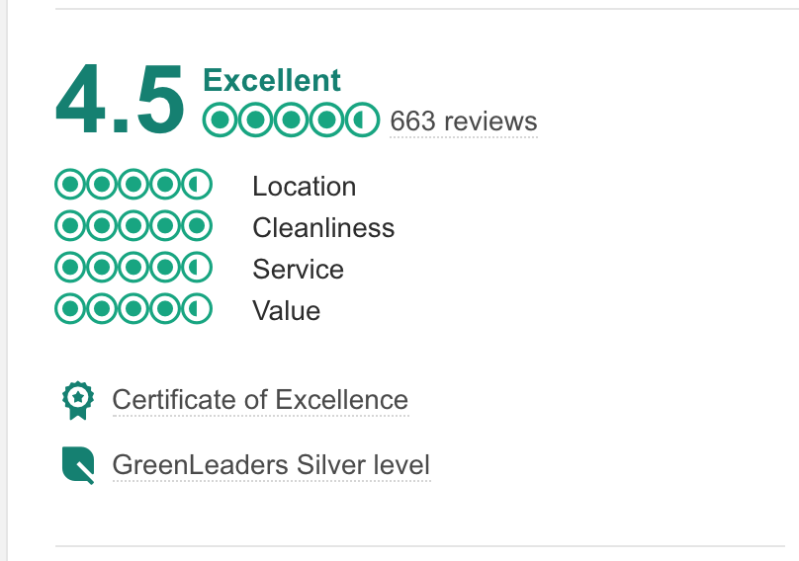
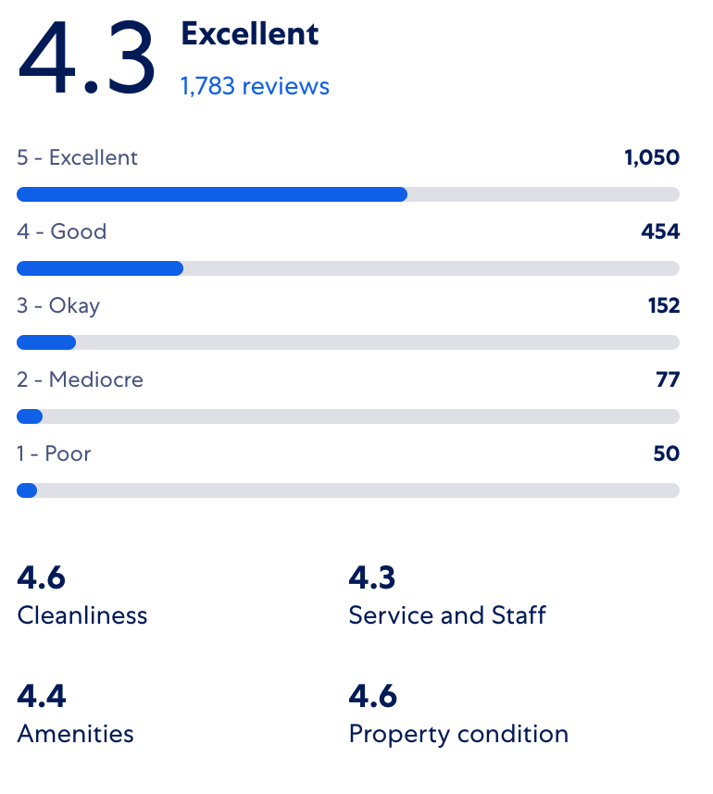
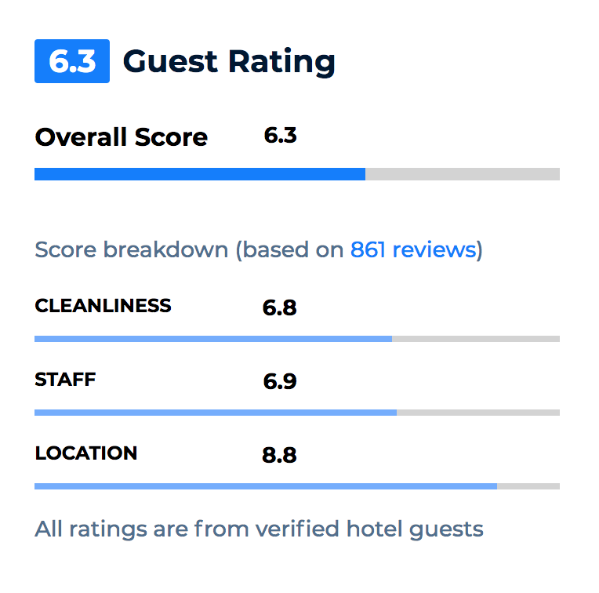
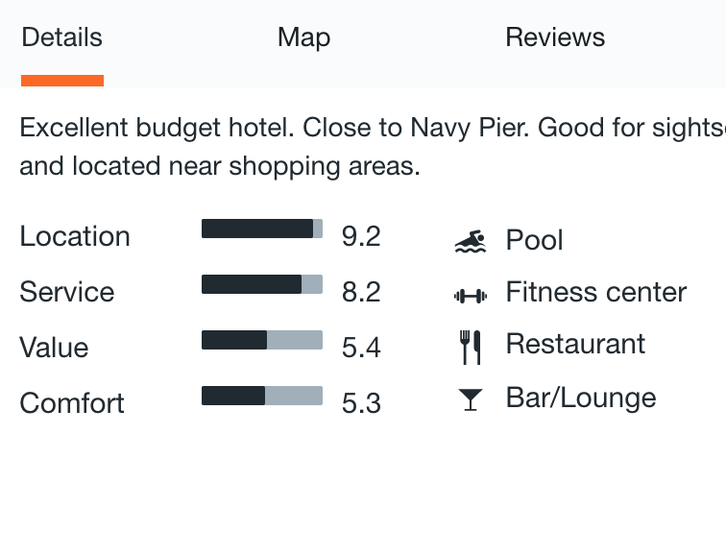
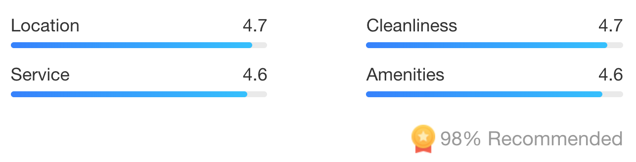
Aspect based hotel ratings
Expedia
Priceline
Kayak
TripAdvisor
Ctrip

Slide 6
Can Groupon just adapt aspect based hotel ratings from other websites?
Groupon
Overall
Rating

Slide 7
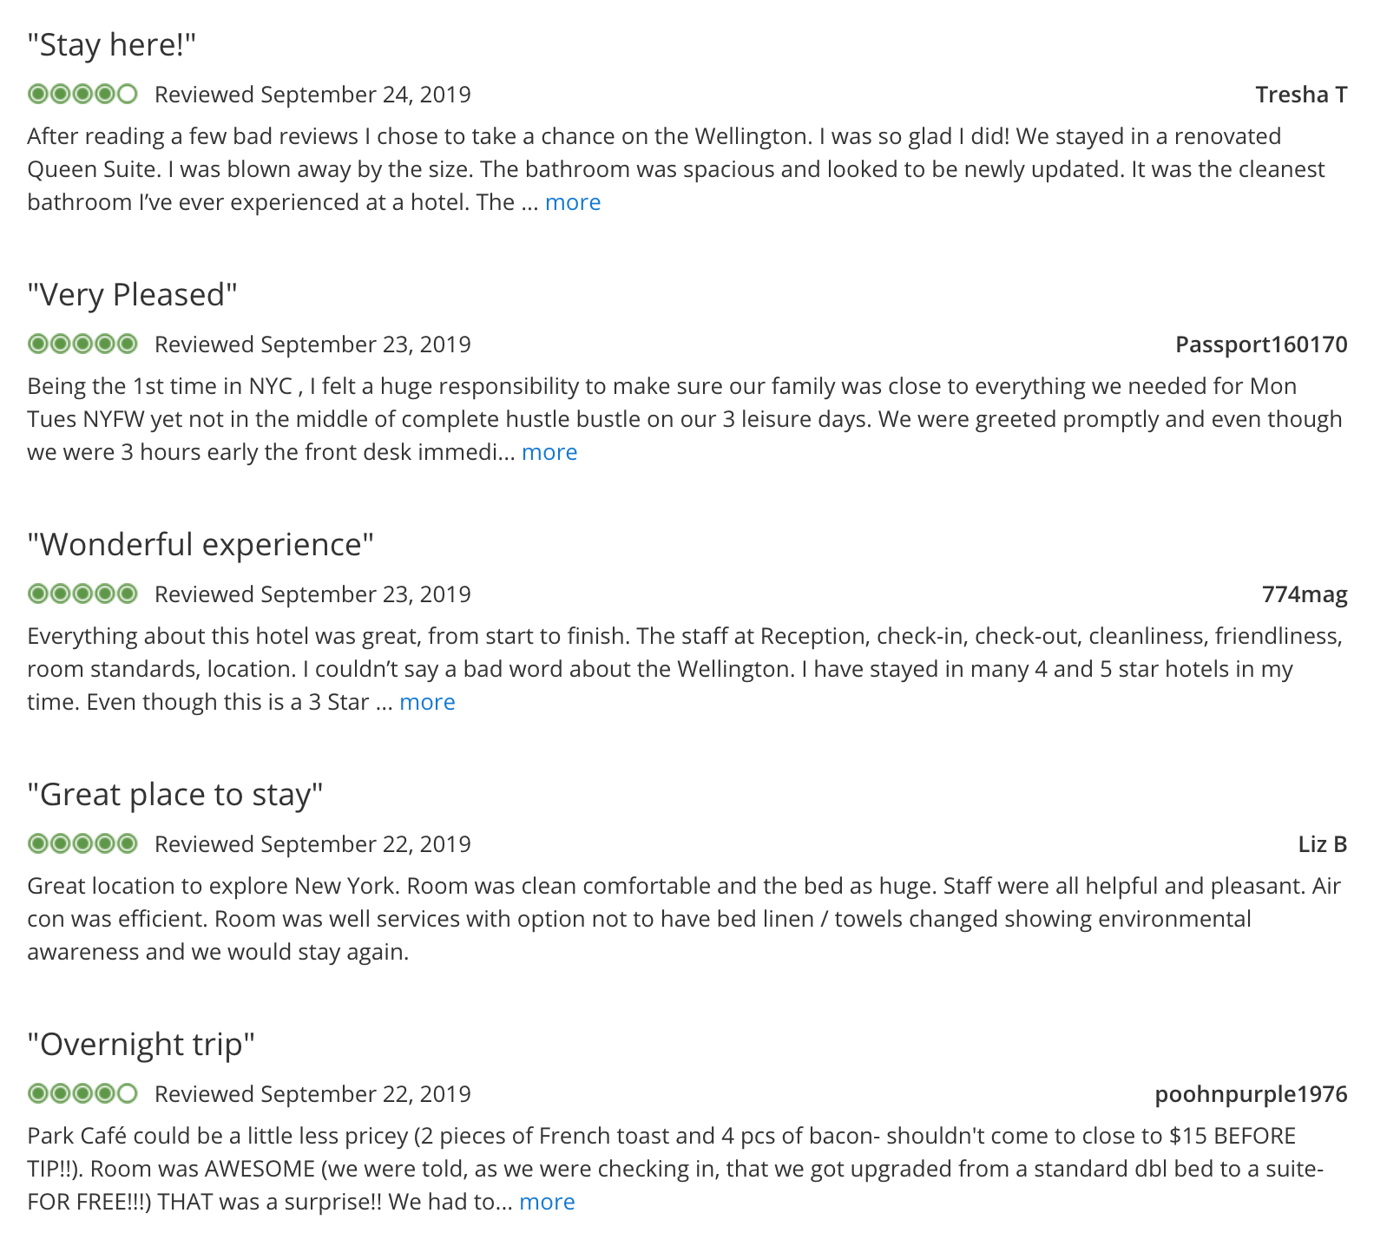
InnSpect can generate aspect-based hotel ratings from reviews
Ratings
Location
Groupon reviews
Service
Room

Slide 8
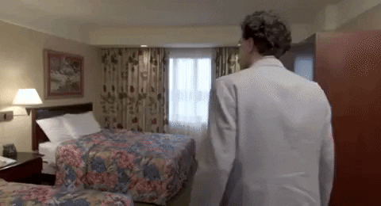
Aspect based sentiment analysis
Grand Hotel is close to everything! The lady at the front desk was very friendly and helpful. But my room was small and had unpleasant smell.

Slide 9
Step 1: Aspect identification
Location
Service
Grand Hotel is close to everything! The lady at the front desk was very friendly and helpful. But my room was small and had unpleasant smell.
Room

Slide 10
Step 1: Aspect identification
Location
Service
Grand Hotel is close to everything! The lady at the front desk was very friendly and helpful. But my room was small and had unpleasant smell.
Room
TripAdvisor Hotel Review Dataset (240k reviews)
Tokenize by sentence + text cleaning
LDA topic clustering
~ 90 % accuracy (bootstrap method)

Slide 11
Step 2: Sentiment analysis
Location:
Service:
Grand Hotel is close to everything! The lady at the front desk was very friendly and helpful. But my room was small and had unpleasant smell.
Room:

Slide 12
Step 2: Sentiment analysis
Location:
Service:
Grand Hotel is close to everything! The lady at the front desk was very friendly and helpful. But my room was small and had unpleasant smell.
Room:
TripAdvisor Dataset (240k reviews with ratings on 6 aspects)
Label reviews for each aspect based on aspect rating
(4,5 -> pos;
1,2 -> neg)
Word2Vec for word embedding
Train Bi-LSTM-RNN model for each aspect
~ 80 % accuracy ~ 0.8 F1 score

Slide 13
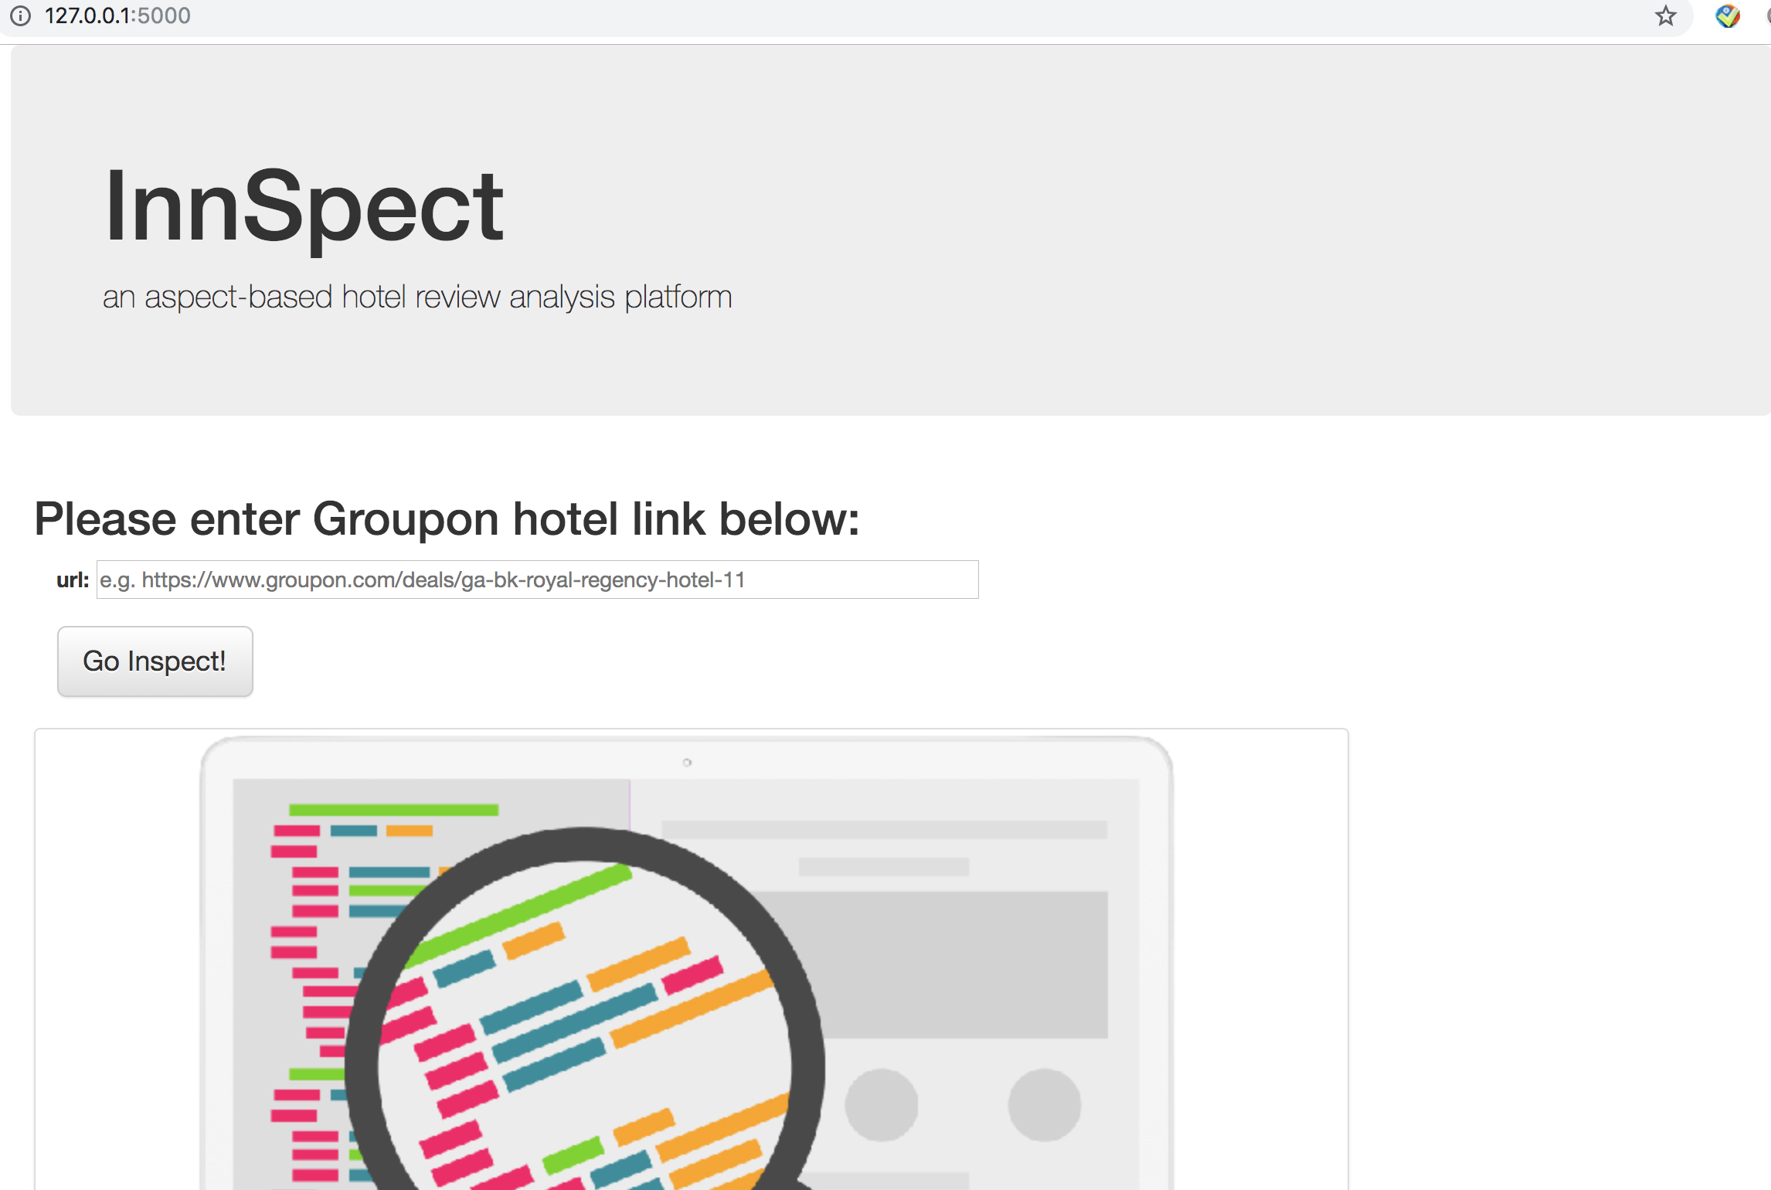
Demo: Input

Slide 14
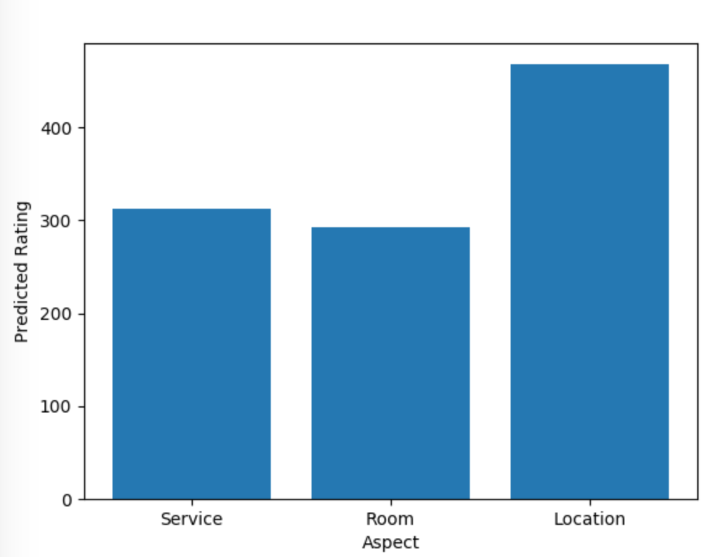
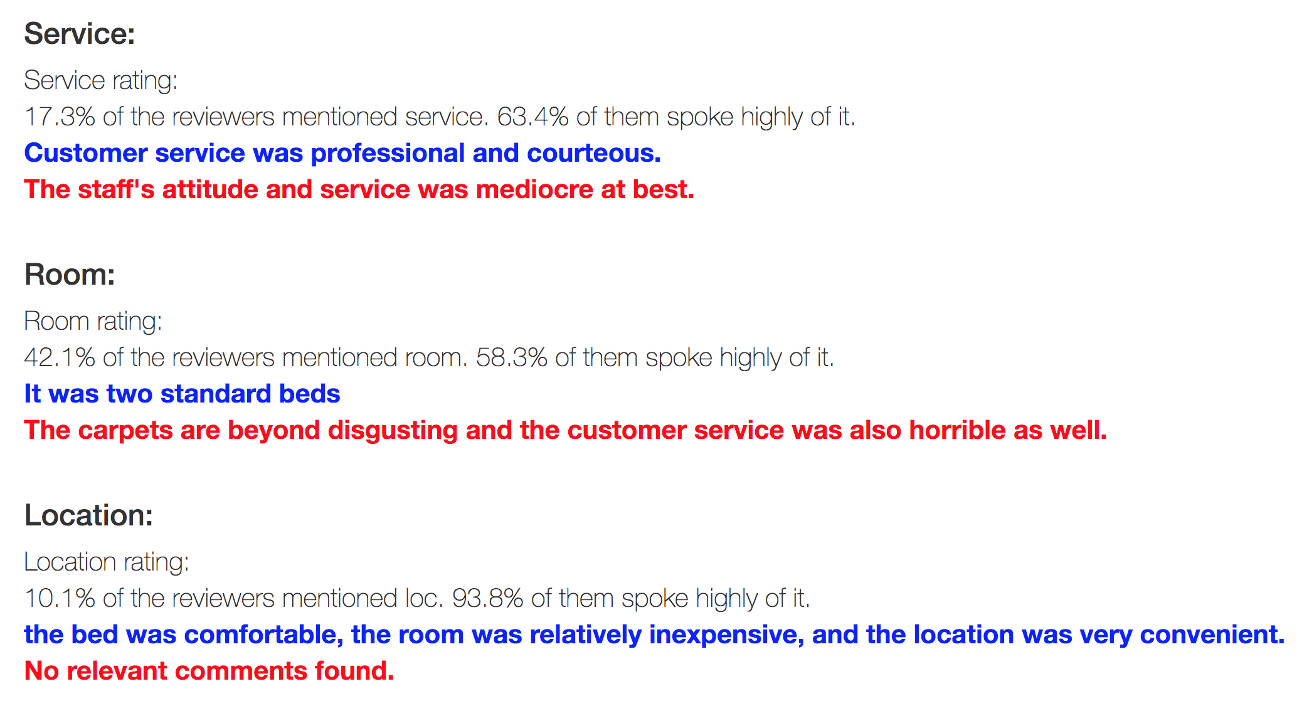
Demo: Output

Slide 15
Evaluation
True Booking Score
Predicted Booking Score
Predicted Groupon Score

Slide 16


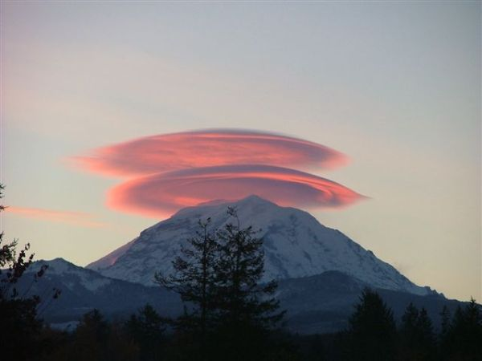

About Chang Zhang:
University of Minnesota
PhD, Computational Materials Science
Data Science Consultant
Software Development Intern

Slide 17
Pipeline for aspect based rating prediction
Location:
Sentiment
Analysis
Grand Hotel is close to everything!
Location: Positive
RNN-loc
Groupon Review
Grand Hotel is close to everything! The lady at the front desk was very friendly and helpful. But my room was small and had unpleasant smell.
Service:
Aspect
Extraction
The lady at the front desk was very friendly and helpful.
Service: Positive
LDA
RNN-serv
Room:
But my room was small and had unpleasant smell.
Room: Negative
RNN-rm

Slide 18
LDA and RNN models generalize the data well
LDA topic | Words
Service | Staff, desk, friendly, front, helpful, service, help
Room | Room, clean, bed, floor, view, small, nice, comfortable
Location | Walk, location, street, great, close, block, beach
Facility | Breakfast, service, good, food, bar, eat, restaurant
Model | Test accuracy | F1-score
RNN - location
RNN - service
RNN - room

Slide 19
Backend model is trained on TripAdvisor hotel reviews with LDA and Bi-LSTM-RNN
location
room
LDA: Topic clustering model trained on sentence level.
food
service
Corpus: TripAdvisor dataset: 240k hotel reviews, each has ratings on 6 different aspects.
facilities
Bi-LSTM-RNN (location):
Sentiment about location: pos/neg
Bi-LSTM-RNN (service):
Sentiment about service: pos/neg
Word2vec for
word embedding
Bi-LSTM-RNN (room):
Sentiment about room: pos/neg

Slide 20
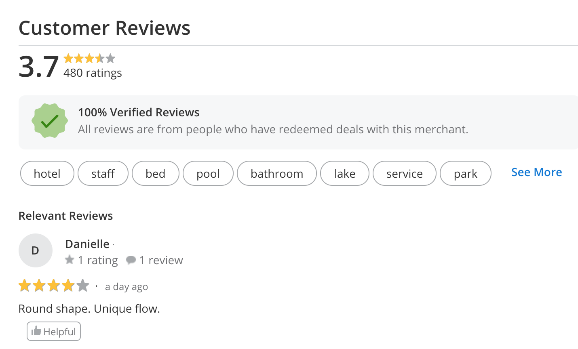
Aspect-based hotel ratings are missing from Groupon
?
TripAdvisor
Expedia
Groupon
How can Groupon provide aspect ratings for its hotels and improve user experience?
Priceline
Ctrip

